Slide 1
Semi-structured data & xml
Presented to:
Sir Asif Sohail
Presented by:
Ayesha Shahid (BCSF18M040)
Rida Afzal Khan (BCSF18M019)
Nowail Zahir (BCSF18M050)

Slide 2
difference between structured and unstructured data and semi structured data
Structured data | Semi-structured data | Unstructured data
Data with a high degree of organization, typically stored in a spreadsheet-like manner | Data with some degree of organization | Data with no predefined organizational form and no specific format
Example: Excel spreadsheets Relational database tables | Example: Hypertext Markup Language (HTML) files JavaScript Object Notation (JSON) files Extensible Markup Language (XML) files | Example: Images such as .jpeg or .png files Videos such as .mp4 or m4a files Sound files such as .mp3 or .wav files Plain text files

Slide 3
Semi-structured Data
Semi-structured data is data that may be irregular or incomplete and have a structure that may change rapidly or unpredictably
It generally has some structure, but does not conform to a fixed schema
Semi-structured data is schema-less and self-describing.
Example :
Information is stored in JSON-style documents which can have varying sets of fields with different data types for each field.
{ name : “Joe”, age : 30, interests : ‘football’ } { name : “Kate”, age : 25 }

Slide 4
Object Exchange Model (OEM)
Data in this model can be considered as a labeled directed graph.
Schema-less and self-describing.
Nodes are objects
Edges are labeled with attribute names
Leaf nodes have atomic values
Each object has a unique object identifier (oid)
Types of OEM Objects:
Atomic objects :
Atomic objects have no outgoing edges and are of types such as int, real, string, gif, java, etc.
Complex OEM:
The complex OEM object can be recognized as ones that have one or more outgoing edges.

Slide 5
Each object in OEM has the following structure:
Label: A variable character string describing what the object represents.
Type: The data type of the object’s value.
Value: A variable-length value of the object.
OID: Object unique identifier
Label
Type
Value
OID

Slide 6
DBGroup
&1
Member
Project
Member
Member
Project
Member
&2
&3
&4
&5
&6
Name
Name
Project
Office
Name
Age
Age
Project
Office
Office
&7
&8
&9
&10
&11
&12
&13
&14
&15
&16
“Clark”
“Smith”
46
“Gates 252”
“Lore”
“Tsimmis”
“Jones”
28
Building
Room
Building
Room
&17
&18
&19
&20
“CIS”
“411”
“CIS”
252

Slide 7
Lore and Lorel
Lore :
Lore is Lightweight Object Repository
Lore is a DBMS designed specifically for managing semi-structured information, such as XML
The data model used in Lore is a "lightweight" object model called OEM ( Object Exchange Model)
Lore itself also is "lightweight," in the sense that it is a repository and a query engine but not a full-feature database management system.
Lorel:
Lorel (Lore’s Query Language) is an extension of Object Query Language(OQL).
Lorel supports path expressions for traversing graph data
A simple path expression is a name followed by a sequence of labels.
DBGroup.Member.Office is a path expression

Slide 8
Example:
Query to get data of office of members having age >30
In SQL style:
Select DBGroup.Member.Office where DBGroup.Member.Age > 30
In OQL style:
select O from DBGroup.Member M, M.Office O where exists y in M.Age : y > 30

Slide 9
Result:
Office “Gates252”
Office
Building “CIS”
Room “411”

Slide 10
DataGuides
DataGuides can handle graph data and arbitrary regular path
A DataGuide has three properties:
Conciseness: Every label path in the database appears exactly once in the DataGuide
Accuracy: Every label path in the DataGuide exists in the original database
Convenience: The DataGuide can be stored and accessed using the same techniques as for the source database.

Slide 11
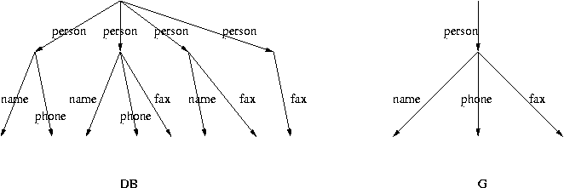
Example:
Given a semi-structured data instance DB, a DataGuide for DB is a graph G such that:
every path in DB also occurs in G
every path in G occurs in DB(Accuracy)
every path in G is unique(Conciseness)

Slide 12
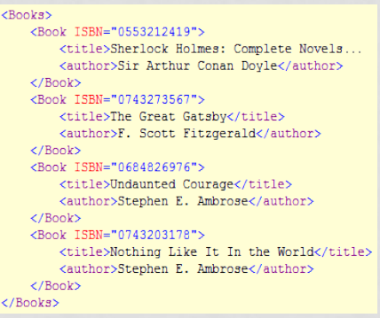
Introduction to XML
XML stands for Extensible Markup Language.
XML is a tag-based notation (language) to describe data
XML is a markup language much like HTML
XML was designed to be self-descriptive
XML was designed to store data

Slide 13
Two types of XML:
Well-Formed XML:
A well-formed XML document is syntactically correct
Data sent without a DTD is Known as well-formed XML.
Valid XML:
A stronger criterion is for an XML document to be valid
Data sent along with a DTD is known as valid XML

Slide 14
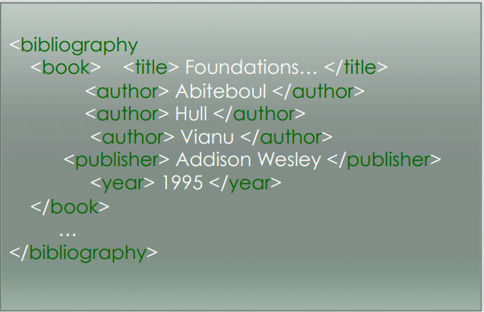
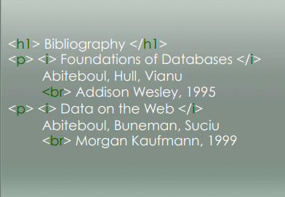
The Difference Between XML and HTML
XML | HTML
XML was designed to carry data with focus on what data is | HTML was designed to display data with focus on how data looks
XML tags describe content (have semantics) | HTML tags describe structure/ presentation

Slide 15
Document Type Deﬁnitions (DTDs)
A DTD defines the structure and the legal elements and attributes of an XML document.
Document Type Definition have a file extension .dtd
A DTD is a document which serves the following purposes:
Specify the valid tags that can be used in a XML document.
Specify the valid tag sequence/arrangements.
DTD defines the structure of xml data and is similar to class template

Slide 16
Main features of DTD:
DTD has 4 types of statements:
DOCTYPE
ELEMENT
Attribtes
ENTITY.

Slide 17
DOCTYPE
DOCTYPE is a DTD statement included in an XML file to declare that this XML document has been linked to a DTD document type and to specify name of root element of this XML document.
It must appear right after the "xml" processing instruction and before the root element.
Key word "SYSTEM" indicates that the external DTD file specified as “Note.dtd" is private
Key word "PUBLIC" indicates that the external DTD file is public.

Slide 18
Element
An element in an DTD file is represented as :
<!ELEMENT ELEMENT_NAME CONTENT_MODEL>
Where:
Name : is the name of the element you are defining.
Content model : specifies what the xml element can contain.
Content Model : PCDATA
• <!ELEMENT BOOK(CHAPTER)>
<!ELEMENT CHAPTER(#PCDATA)>

Slide 19
Element
• For the above dtd declaration a valid xml would be,
<BOOK>
<CHAPTER>
Introduction to xml dtds
</CHAPTER>
</BOOK>

Slide 20
Attributes
• Attributes provide information about a particular element.
• In dtd, an attribute is define as below : –
<!ATTLIST ELEMENT_NAME ATTRIBUTE_NAME TYPE DEFAULT_VALUE >
Example:
<!ATTLIST book id CDATA “123” >

Slide 21
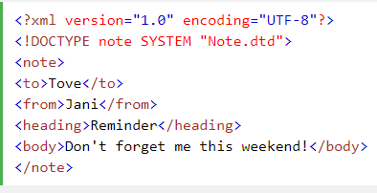
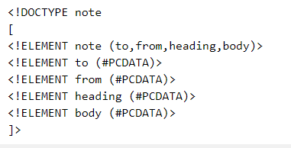
DTD Types:
• External DTD : A dtd that resides in a file (.dtd extension) other than the xml file

Slide 22
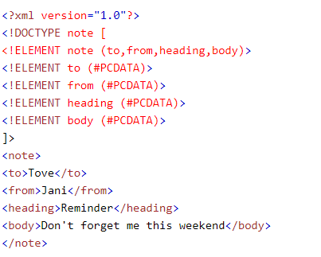
• Internal DTD : Xml and DTD are in the same file

Slide 23
XML Schema
XML schema is a language which is used for expressing constraint about XML documents. There are so many schema languages which are used now a days for example Relax- NG and XSD (XML schema definition).
An XML schema is used to define the structure of an XML document. It is like DTD but provides more control on XML structure
An XML document is called "well-formed" if it contains the correct syntax. A well-formed and valid XML document is one which have been validated against Schema.

Slide 24
XML Schema Data types:
There are two types of data types in XML schema.
Simple Type
Complex Type
Simple Type: The simple Type allows to have text-based elements. It contains less attributes, child elements, and cannot be left empty.
Complex Type: The complex Type allows to hold multiple attributes and elements. It can contain additional sub elements and can be left empty.

Slide 25
Resource Description Framework (RDF)
RDF is a W3C standard, which
provides tool to describe Web resources
provides interoperability between applications that exchange machine- understandable information
RDF statement:
Subject of an RDF statement is a resource
Predicate of an RDF statement is a property of a resource
Object of an RDF statement is the value of a property of a resource
RDF Properties:
Type
subClassOf
subPropertyOf
range , domain, label, comment

Slide 26
RDF data model:
The basic RDF data model consists of three objects:
Resource: which is anything that can have a URI; for example, a Web page, a number of Web pages, or a part of a Web page, such as an XML element.
Property: which is a speciﬁc attribute used to describe a resource. For example, the attribute Author may be used to describe who produced a particular XML document.
Statement: which consists of the combination of a resource, a property, and a value. These components are known as the ‘subject’, ‘predicate’, and ‘object’ of an RDF statement

Slide 27
RDF Schema:
RDF Schema is a W3C standard which defines vocabulary for RDF organizes this vocabulary in a typed hierarchy capable to explicitly declare semantic relations between vocabulary terms
Limitation of RDF
RDF Schema is a vocabulary description language for describing properties and classes of RDF resources, with a semantics for generalization hierarchies of such properties and classes.
RDFS is useful, but does not solve all possible requirements.

Slide 28
XML Query Languages
XQL (XML Query Language) is a way to locate and filter the elements (data fields) and text in an Extensible Markup Language (XML) document.
Two standard languages for DBMSs, namely SQL and OQL, do not apply directly to XML because of the irregularity of XML data. However, XML data is similar to semi-structured data so, there are many semi-structured query languages that can be used to query XML documents, including XML-QL ,XQL

Slide 29
XML Query Working Group
W3C formed an XML Query Working Group in 1999 to produce a data model for XML documents, a set of query operators on this model, and a query language based on these query operators.
Queries operate on single documents or ﬁxed collections of documents, and they can select entire documents or subtrees of documents that match conditions based on document content and structure.
Queries can also construct new documents based on what has been selected. Ultimately, collections of XML documents will be accessed like databases
At the time of writing, this Working Group has produced a number of documents:
XML Query (XQuery) Requirements
XML XQuery 1.0 and XPath 2.0 Data Model
XML XQuery 1.0 and XPath 2.0 Formal Semantics
XQuery 1.0 – A Query Language for XML
XQuery 1.0 and XPath 2.0 Functions and Operators

Slide 30
XQuery:
The W3C Query Working Group has proposed a query language for XML called XQuery. XQuery is derived from an XML query language called Quilt
XQuery is a functional language in which a query is represented as an expression. The value of an expression is always a sequence, which is an ordered collection of one or more atomic values or nodes

Slide 31
SPARQL
SPARQL (Simple Protocol and RDF Query Language), pronounced “sparkle,” is an RDF query language that has been developed by the RDF Data Access Working Group (DAWG) of the W3C, and is considered a component of the Semantic Web.
As RDF is built on the triple, a 3-tuple consisting of subject, predicate, and object. In the same way, SPARQL is built on the triple pattern, which also consists of a subject, predicate, and object and is terminated with a full stop. In fact, an RDF triple is also a SPARQL triple pattern.

Slide 32
Path expressions
Relative path:, child::Features
absolute path expression : ( /child::ProductDescription),
doc("books.xml")/bookstore/book[price>30]/title
for $x in doc("books.xml")/bookstore/book where $x/price>30 order by $x/title return $x/title
where $x is a variable to hold these elements.

Slide 33
FOR and LET Clause: Generate a List of Tuples that Preserves Doc Order
WHERE Clause: Applies a Predicate to Eliminate Some Tuples
RETURN Clause: Executed on Resulting Tuples -> Ordered Output List
A FLWR expression binds values to one or more variables and then uses these variables to construct a result

Slide 34
The XQuery Update Facility introduces five new kinds of expressions: insert
delete
replace
rename
transform expressions

Slide 35
XML and Databases
As the amount of data in XML format expands, there will be an increasing demand to store, retrieve, and query this data.
It is anticipated that there will be two main models that will exist:
Data-Centric :
In a data-centric model, XML is used as the storage and interchange format for data that is structured, appears in a regular order, and is most likely to be machine processed instead of read by a human
Document-Centric: In a document-centric model, the documents are designed for human consumption (for example, books, newspapers, and email). Due to the nature of this information, much of the data will be irregular or incomplete, and its structure may change rapidly or unpredictably. Content management systems are an important tool for handling these types of documents. Underlying such a system there may now be a native XML database (NXD).

Slide 36
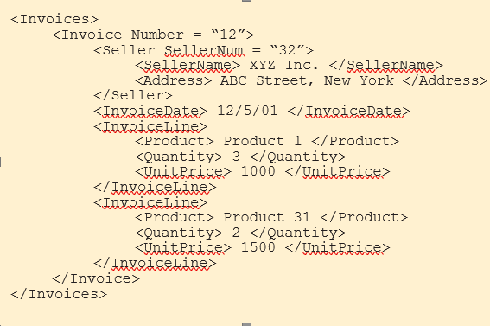
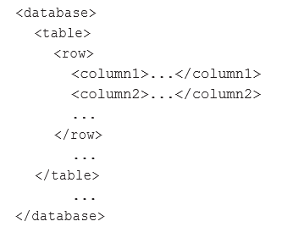
Data centric

Slide 37
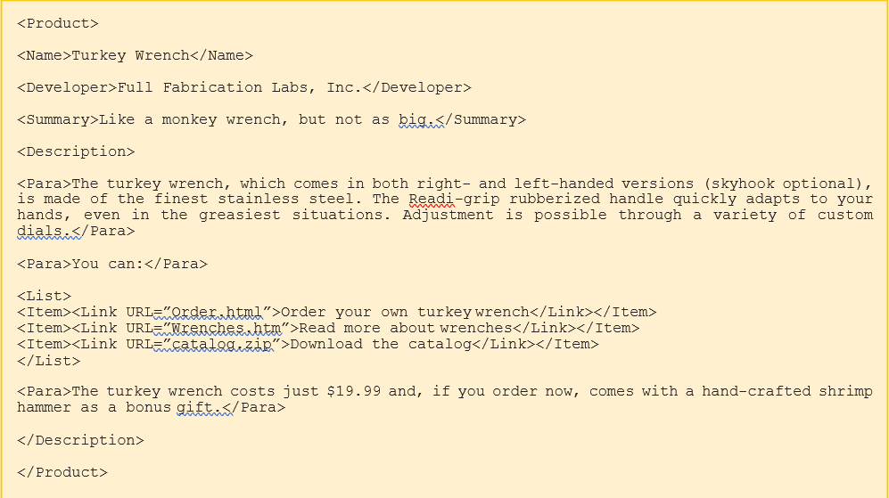
Document centric

Slide 38
Storing XML in Databases
There are four general approaches to storing an XML document in a relational database:
store the XML as the value of some attribute within a tuple
store the XML in a shredded form across a number of attributes and relations
store the XML in a schema-independent form
store the XML in a parsed form; that is, convert the XML to internal format, such as an Infoset or PSVI representation, and store this representation.
Storing the XML in an attribute: In this approach, in the past the XML would have been stored in an attribute whose data type was character large object (CLOB). More recently, some systems have implemented a new native XML data type. In Oracle, this data type is called XML Type (although the underlying storage may be CLOB)

Slide 39
Storing the XML in shredded form:
With this approach, the XML document is decomposed into its constituent elements and the data distributed over a number of attributes in one or more relations. The term that is used for this decomposition is shredding

Slide 40
XML and SQL
The SQL:2011 standard has defined extensions to SQL to enable the publication of XML, commonly referred to as SQL/XML. In particular, SQL/XML contains:
a new native XML data type, XML, which allows XML documents to be treated as relational values in columns of tables, attributes in user-defined types, variables, and parameters to functions
a set of operators for the type
an implicit set of mappings from relational data to XML.

Slide 41
Mapping tables to XML documents :
The mapping of an individual table is achieved by creating a root element named after the table with an element for each row. Each row contains a sequence of column elements, each named after the corresponding column. Each column element contains a data value. The values of predefined types are first case to a character string and then the resulting string is mapped to the string representation of the corresponding XML value. Values of numeric types are mapped with no periods.
Generating an XML Schema :
An XML Schema is generated by creating globally named XML Schema data types for every type that is required to describe the tables(s) being mapped. A naming convention is used to name the mapped data types by using a suffix containing length or precision/scale to the name of the base type. For example, CHAR(10) would be named CHAR_10, DECIMAL(8, 2) would be named DECIMAL_8_2, and INTEGER would remain as INTEGER.

Slide 42
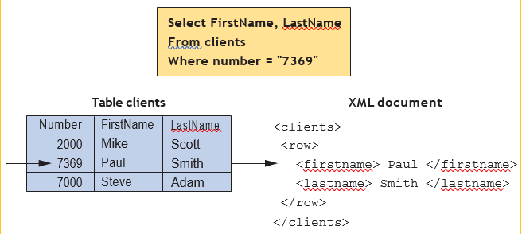

Slide 43
Native XML Databases
Native XML Databases:
A native XML database defines a (logical) data model for an XML document (as opposed to the data in that document) and stores and retrieves documents according to that model.
At a minimum, the model must include elements, attributes, PCDATA, and document order. The XML document must be the unit of (logical) storage although it is not restricted by any underlying physical storage model (so traditional DBMSs are not ruled out but neither are proprietary storage formats such as indexed, compressed files).
Types:
The two main types of native XML DBMS:

Slide 44
text-based
which stores the XML as text, for example, as a file in a file system or as a (character large object )CLOB in a relational DBMS
model-based
which stores the XML in some internal tree representation, for example, an Infoset or PSVI representation, or a DOM representation, possibly with tags tokenized. This approach makes it straightforward to identify and retrieve information based on the structure of the XML document in addition to its contents, and often provides good performance for indexing based on element values.

Slide 45
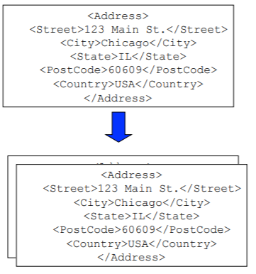
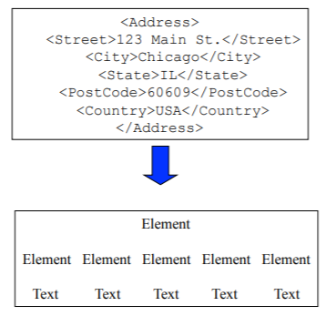
Text based model based

Slide 46
THANK YOU

Slide 47
Any Question?

